Slide 1
BANK MANAGEMENT SYSTEM
A comprehensive Java-based console application for banking operations.
PRESENTED TO:
SIR KHURAM IQBAL
PRESENTED BY:
ALI HAMZA {004}

Slide 2
Introduction
The Bank Management System serves as a prototype that simulates essential banking functions, allowing users to manage accounts, transfer funds, and track transactions securely.

Slide 3
01
Overview

Slide 4

Java-based application
This system is developed as a console application using Java, providing a user-friendly interface for managing banking operations effectively.

Slide 5
User roles: Administrators and Users
The application supports two roles: Administrators who have full access to manage accounts, and Users who can view and interact with their personal account details.

Slide 6
Core banking operations
Key functionalities include account creation, updates, search capabilities, fund transfers, and transaction logs, ensuring a comprehensive banking experience.

Slide 7
PROGRAM FLOW

Slide 8
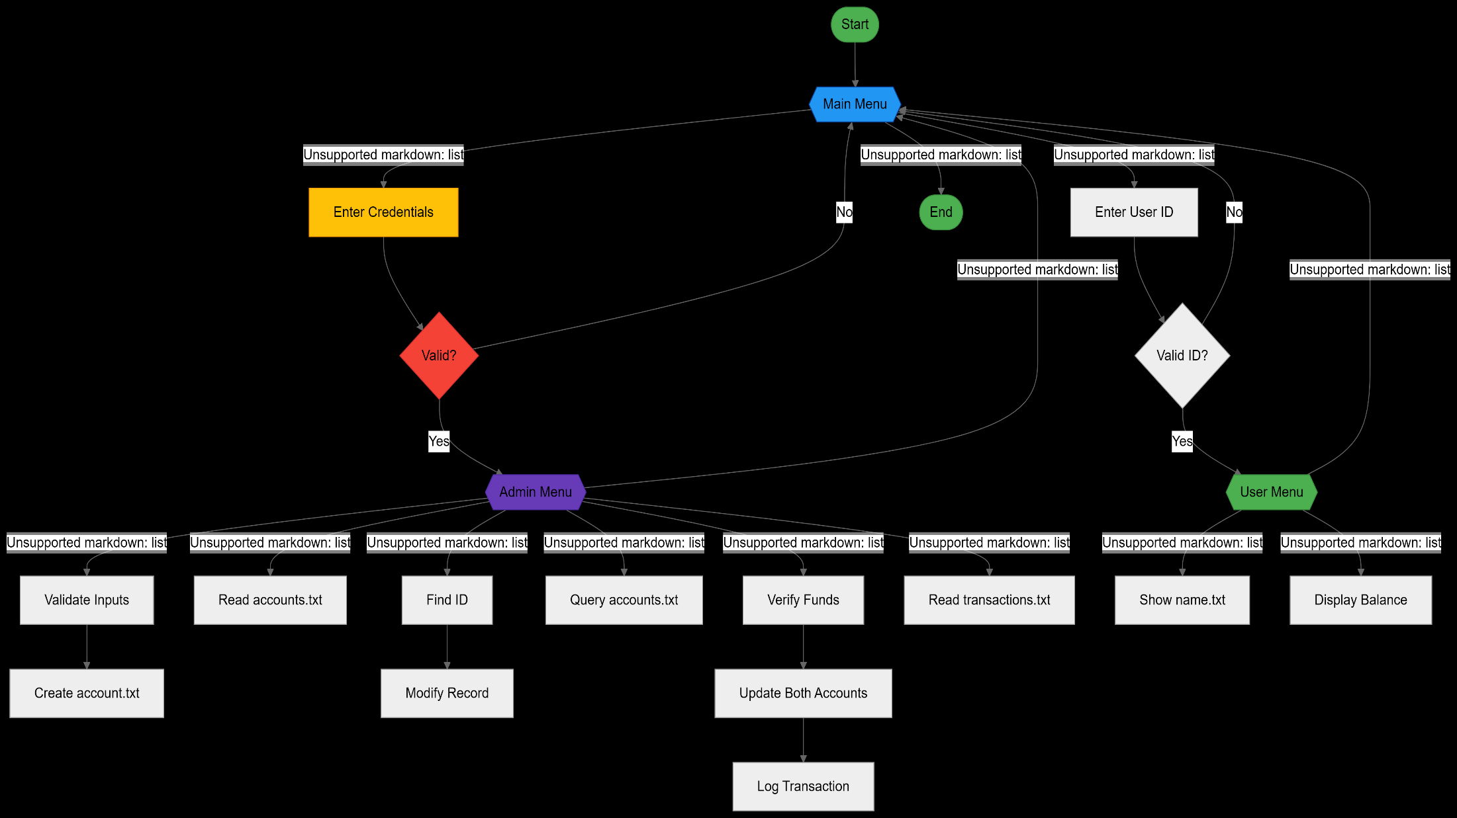







FLOW CHART

Slide 9
02
Key Features

Slide 10

Admin functions: account management
Administrators can create, view, update, and search for accounts, as well as process fund transfers and view transaction logs seamlessly.

Slide 11
User functions: account access
Users can view their account details, check balances, and log out easily, ensuring secure access to personal banking information.

Slide 12
Transaction handling
The application efficiently handles fund transfers between accounts and logs these transactions, providing a complete audit trail.

Slide 13
03
Code Structure

Slide 14
Classes and methods overview
The system is structured into various classes, each responsible for specific functionalities like authentication, account management, and transaction processing.

Slide 15

File usage: accounts.txt and transactions.txt
Data is stored in text files, including accounts.txt for account information and transactions.txt for logging all fund transfers, enabling easy access and management.

Slide 16
Input validation and authentication
The system incorporates robust input validation to prevent errors and ensure data integrity, coupled with an authentication mechanism for secure admin logins.

Slide 17
04
Strengths

Slide 18
Modular design benefits
The modular design allows clear separation between user roles and functionalities, facilitating easier maintenance and scalability of the application.

Slide 19

File-based persistence advantages
Utilizing text files for data storage eliminates the need for complex database management, enabling quick access and simplicity in data handling.

Slide 20
Transaction logging for auditability
Every fund transfer is logged with timestamps, ensuring an accurate audit trail that enhances transparency and accountability in banking operations.

Slide 21
05
Running the System

Slide 22

Compilation and execution steps
To run the system, ensure Java 8 or higher is installed, compile the main class using 'javac', and execute it using 'java', following the provided instructions.

Slide 23
Test credentials for access
Default credentials for testing include an admin account with username 'Admin' and password 'Admin1234', along with valid user IDs listed in accounts.txt.

Slide 24
System requirements
The application requires Java Runtime Environment (JRE) 8 or higher and a compatible text editor or IDE for compiling and running the Java files.

Slide 25
Conclusions
The Bank Management System is a functional prototype with core features for managing accounts.

Slide 26
THANK YOU

